Slide 1

Transfer-Matrix Abstraction To Analyze The Effect Of Manufacturing Variations In Silicon Photonic Circuits
Team: Carlos Gonzalez-Campos
Faculty Advisors: Dr. Priyank Kalla,
Dr. Angela Rasmussen

Slide 2
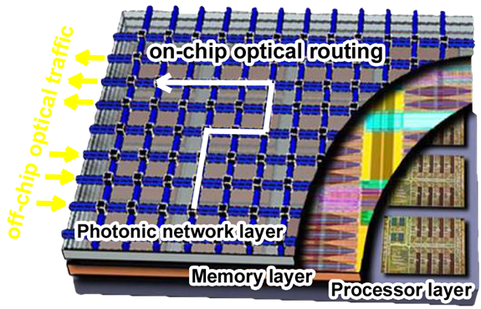
Motivation
The emergence of Silicon (Si) photonics necessitates the development of automated testing and validation techniques/tools.
Si photonics have widespread applications in fields such as communication, signal processing, quantum, reversible computation and optical sensing.
Image credit: IBM

Slide 3
Background Info
Silicon waveguides are transparent to telecommunication wavelength
Enables guide wave ranges, enabling them to guide wave transmission in the medium.
Silicon and silicon dioxide are ideal for constructing optical waveguides given the large refractive index contrast between the two, we focus on transmission at 1550nm.
We can represent optical systems with transfer matrices.

Slide 4
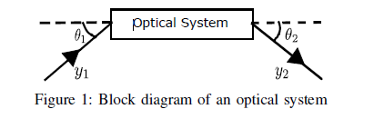
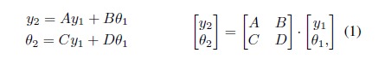
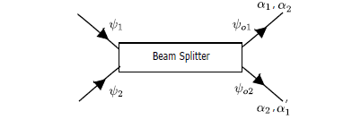
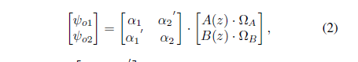
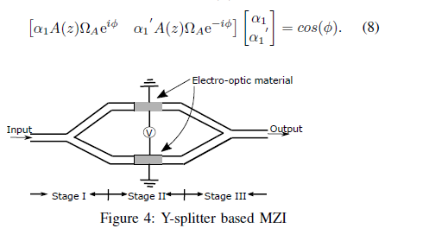
Optical Systems & Transfer Matrices

Slide 5
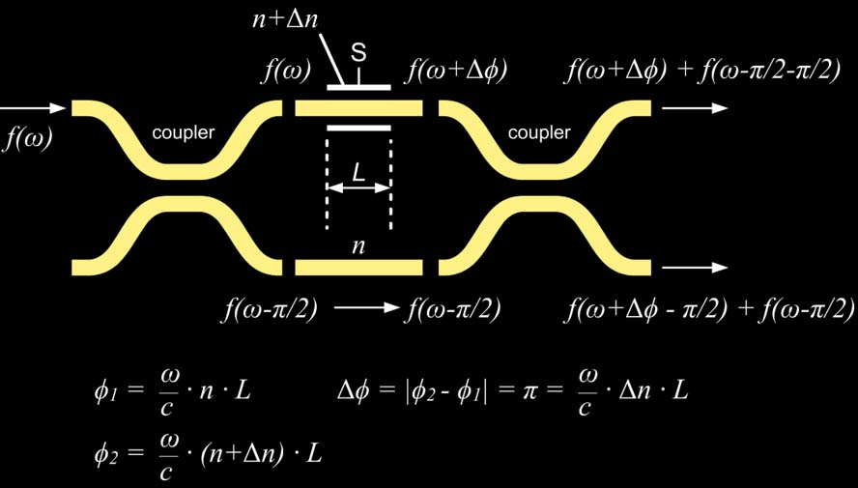




Mach-Zehnder Interferometer (MZI)
S = 0 → Δφ = π → bar
S = 1 → Δφ = 0 → cross

Slide 6
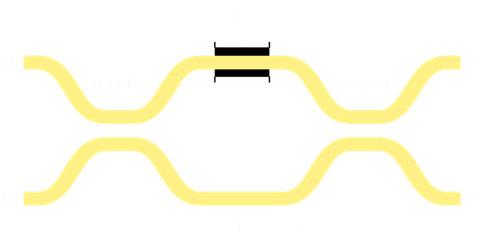
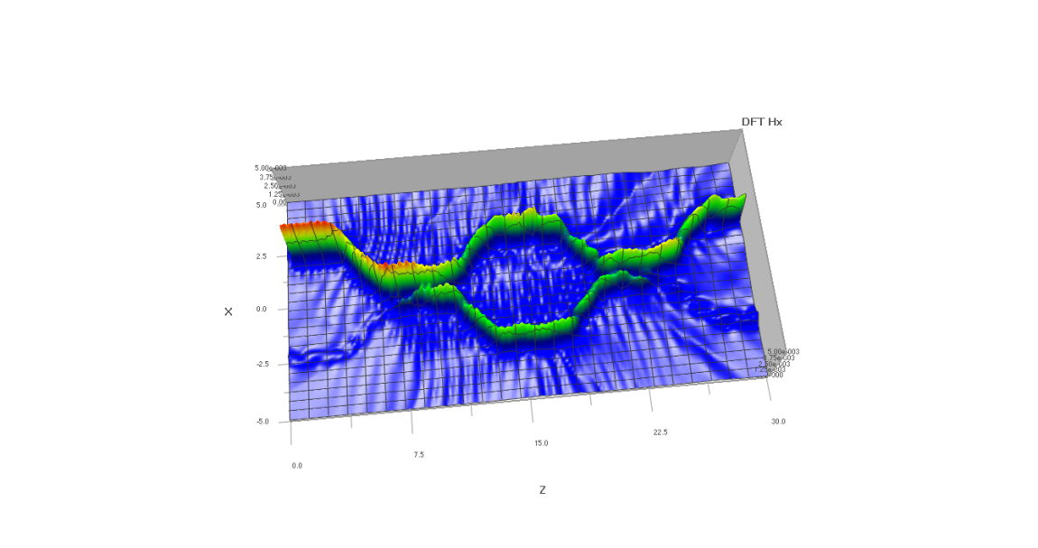
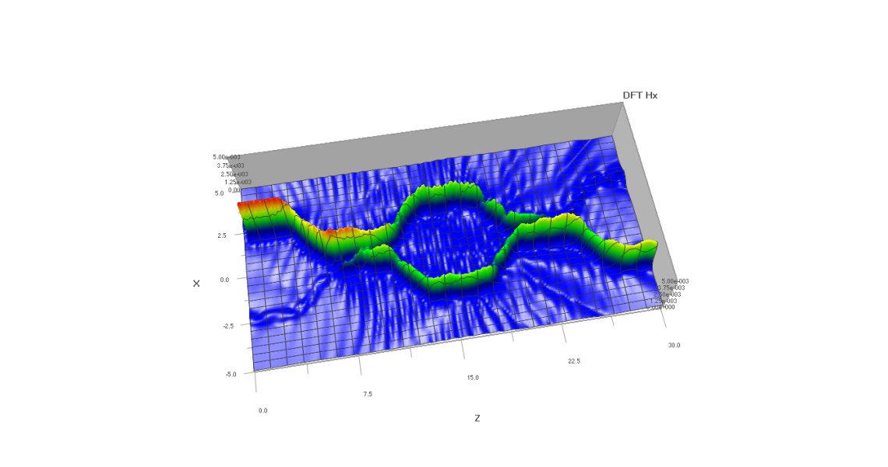
Crossbar Gates – Logic Building Block
Electrically controlled 2x2 Optical Router (“switch”)
s = electrical primary input
a, b, c, d = optical waveguides
Crossbar Gate
S = 0 (bar) → (a = c, b = d)
S = 1 (cross) → (a = d, b = c)

Slide 7
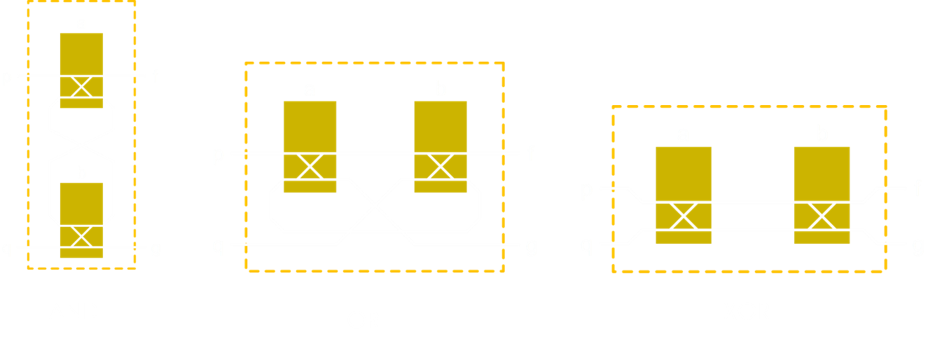
Virtual Gate Operators for Optical Boolean Functions

Slide 8
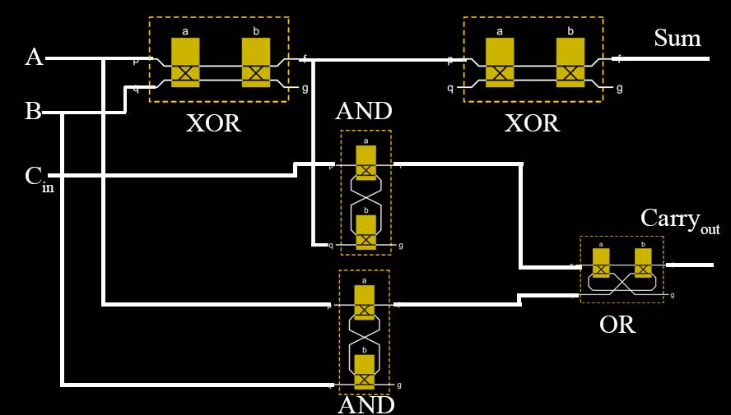
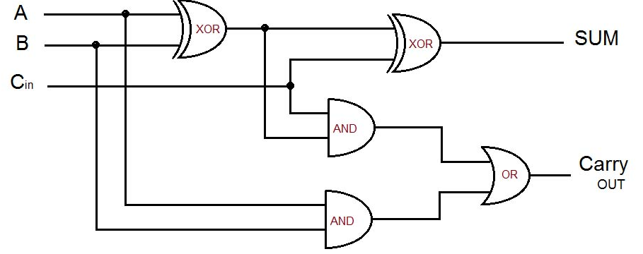
Build Circuits Using Virtual Gates

Slide 9
Goals
Full-scale FDTD 3D simulations can simulate a device, but not a large circuit.
Simulate large circuits.
Transfer matrices are an abstraction for quick solving instead of using FDTD methods.
Create a Python program that can simulate and run silicon photonic circuits using a more structured procedure.
Create a file format to store and read optical photonic circuits.
Extract functional parameters in transfer matrices for simulation.

Slide 10
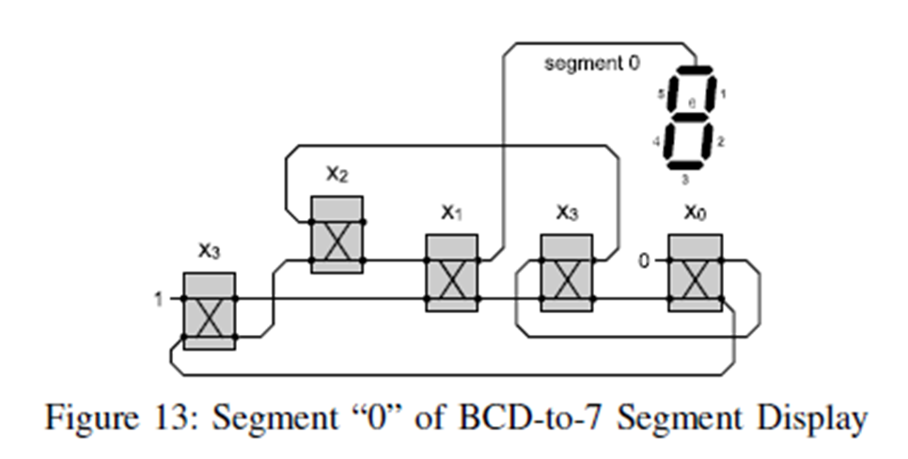
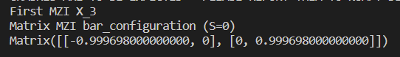
1st Experiment
Recreate this circuit with my structured Python program.
Confirm the output of MZI X₁

Slide 11
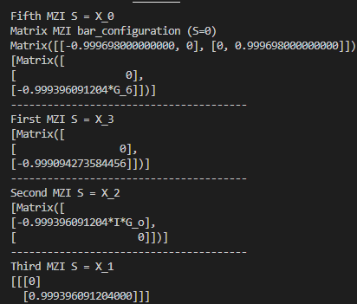
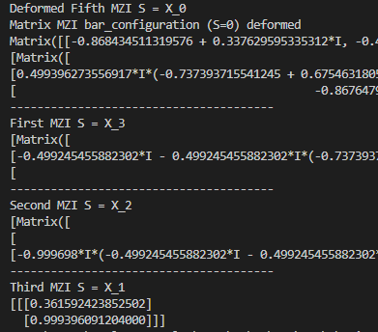
1st Experiment Cont..

Slide 12
2nd Experiment
Now I am running through all 16 input entries for X_{0,} X_{1,} X_{2,} X_{3.}
Interested in seeing how the circuit will react
Dead loops
No Output

Slide 13
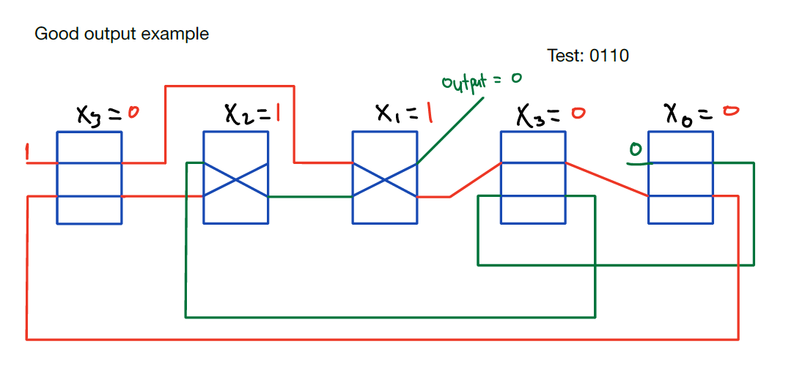
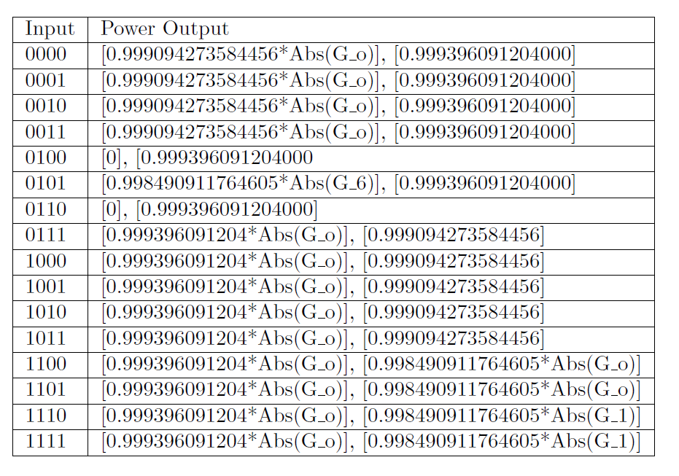
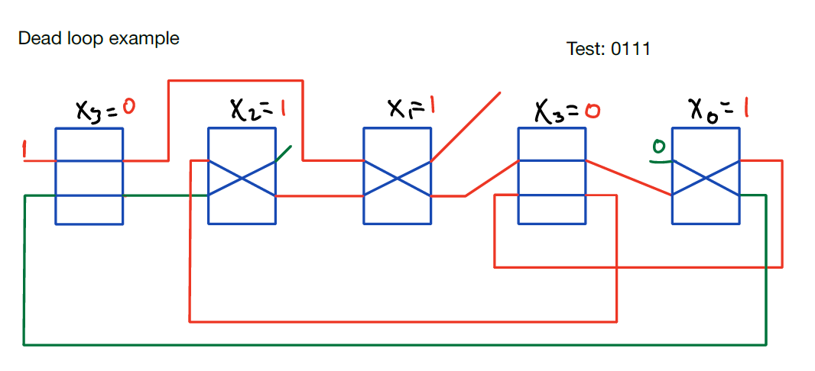
2nd Experiment cont..
Findings:
Dead loops
Working Inputs

Slide 14
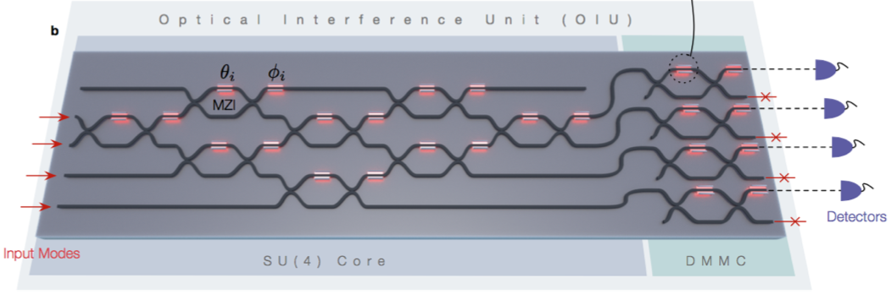
Conclusion
Useful tool to test more complex linear optical circuits.
A high-level abstraction to validate silicon photonic circuits.
Can help analyze the effect of manufacturability variations and defects in silicon photonic circuits.

Slide 15
Thank You

